Slide 1
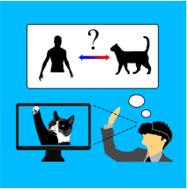
Self-Illusion: A study on Cognition of Role-Playing in Immersive Virtual Environments from Non-Human Perspective
AuthorS:
Sheng Li, (Member, IEEE), Xiang Gu, Kangrui Yi, Yanlin Yang, Guoping Wang, Dinesh Manocha, (Fellow, IEEE)
Published in: IEEE Transactions on Visualization and Computer Graphics On: 14 December 2020 Pages: 15
Name: Martim Neves, Nmec: 88904
Study Program: MIECT
Course: RVA
Date: 18/1/2022

Slide 2
Why this paper?
New psychological component of presence
New metric to measure presence and immersion
Multiple uses and beneficts

Slide 3
Context
How to measure presence and immersion in a Virtual Environment (VE)?
Place Illusion (PI)
Plausibility Illusion (Psi)
Sense of Embodiment (SoE)
Virtual Body Ownership (VBO)

Slide 4
Context
PI is is where a person experiences something as if it were physically there
Psi is “the illusion that what is apparently happening is really happening (even though you know for sure that it is not).” It describes a correlation between individual perceptions and virtual events

Slide 5
Context
SoE is a body-level illusion and describes the sensation of owning, controlling, and being inside the virtual body
VBO can be described as accepting the body as the own, as the source of all senses and perception

Slide 6
Self-Concept and Self-Illusion
Self-Concept is “the individual’s belief about himself/herself, including the person’s attributes and who and what the self is.”
Therefore…
Self-Illusion (SI) is “the generalized illusion of being in a role despite sure, cognitive knowledge that one is not that role”, which is the same as an illusion of self-concept

Slide 7
Experiment
Role Selection
The role should not be created or imagined by experimenters
The role’s behavior pattern should be distinct from the person’s normal behavior pattern
Human related roles were discarded and non-human roles were considered (animals)
Users should have relatively similar levels of familiarity with the nature of this animal role
Animals like snakes or frogs were discarded and it was concluded that domesticated animals were the best choice
After a university-based survey, a cat was selected as the role due to familiarity and more harmonious interactions than dogs

Slide 8
Experiment
Apparatus and System
HTC Vive (immersive VR headset with wireless suite)
Noitom Hi5 VR Glove (motion capture, all fingers exposed, without any digital force/haptics feedback)
Data gloves used for hand motion tracking and gesture tracking
User’s fingers exposed; therefore, user could touch physical world to get haptic feedback
Cat simulation system in Unity3D

Slide 9
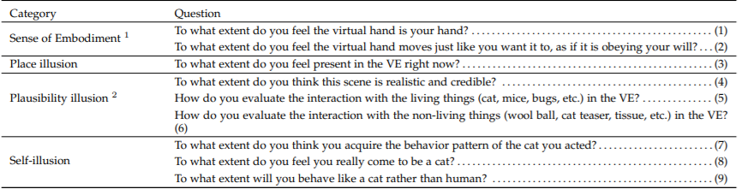
Experiment
Design - DVs and IVs
Two dependant variables (DV) were created to validate the existence of self-illusion and investigate the differences between Psi and SI: participants’ actual degrees of Psi and their degrees of hypothesized SI
Psi, PI, SoE, and SI were measured using a 7-point Likert questionnaire
Two independant variables (IV) were created: Manipulation of Psi (MoP) and Manipulation of SI (MoS)

Slide 10
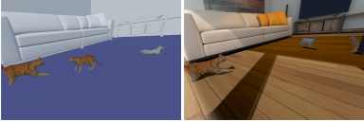
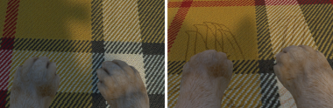
Experiment
Design – MoP
Expected to bring different levels of Psi by varying the quality of the scenario and providing different levels of fidelity of physical perception and feedback
Two levels of Psi:
Level 0 (MoP-0): The scenes in the VE were rendered with lower realism; no perceptually consistent interaction and no high-fidelity feedback when the user interacts with the virtual world by scratching fingers
Level 1 (MoP-1): In contrast, the scenes were rendered with higher realism; perceptually consistent interaction with the virtual world to get high-fidelity feedback when scratching fingers

Slide 11
Experiment
Design – MoS
Expected to bring different levels of hypothesized self-illusion by enacting different levels of self-conversion to the role on identity recognition and by providing event consistency/inconsistency with the assigned tasks
Two levels of SI:
Level 0 (MoS-0): No avatar; the assigned tasks were inconsistent with the events shown in the tutorial stage
Level 1 (MoS-1): Personalized avatar with many options available where the whole body could be observed in the VE; the assigned tasks were consistent with the events shown in the tutorial

Slide 12
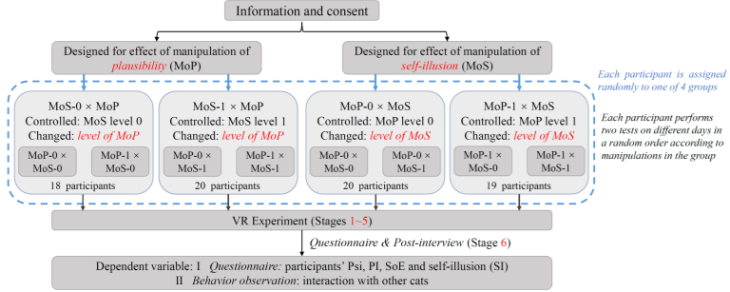
Experiment
Design – Mixed Design
Within-group design discarded because would lead to 4 different tests and practice effect
Mixed-design with only 2 tests per participant and repeated measures ANOVA
4 groups created: MoS-0×MoP, MoS-1×MoP, MoP-0×MoS, and MoP-1×MoS to study the effects of MoS and MoP
Participants in MoS-0×MoP share the within-group factor: MoP
When compared with participants in MoS-1×MoP, share the between-group factor: MoS

Slide 13
Experiment
Participants
77 participants (36 male, 41 female), between 18 and 28 years old
46 were undergraduates and 31 were graduate students
Every participant had normal or corrected-to-normal vision and the headset was calibrated for each user
Video game experience and cat familiarity was collected using a 7-point Likert scale
People with strong emotions towards cats were not selected to avoid bias

Slide 14
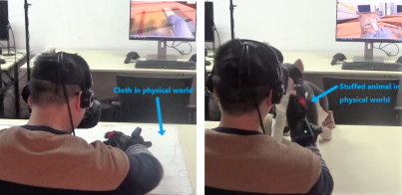
Experiment
Procedure
Stage 1 - watching a tutorial video detailing cat behavior in 3 scenarios: catching mice, playing with a cat teaser and pulling tissues
Stage 2 - identity recognition stage; participants in MoS-1 could choose their avatar from various appearences provided
Stage 3 - physical perception stage; participants in MoP-1 were provided with a piece of cloth and scratch marks appeared on the virtual cloth when touching the real world cloth

Slide 15
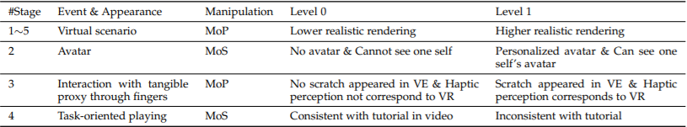
Experiment
Procedure
Stage 4 - task-oriented playing stage; participants in MoS-1 were given 3 mini-games shown in tutorial to play
Stage 5 - interaction with other cats stage; a cat approaches the participant in the virtual world and the participant is asked to interact with it
Stage 6 – questionnaire and post-interview; after 24 hours each participant repeated stages 1 through 6 with a different manipulation

Slide 16
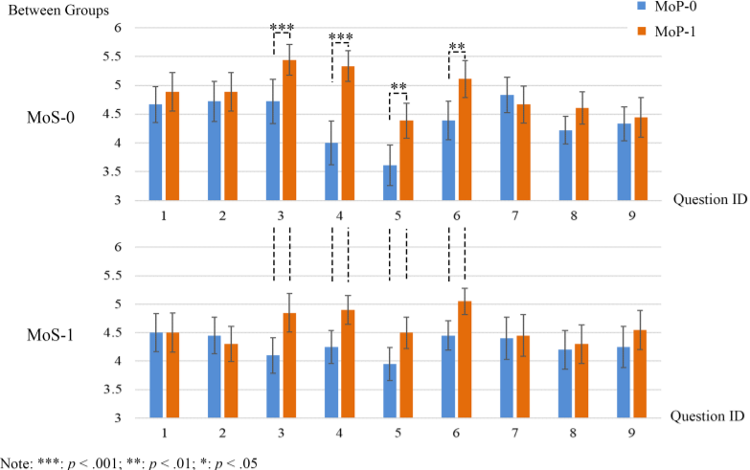
Results and Discussion
Effect of MoP

Slide 17
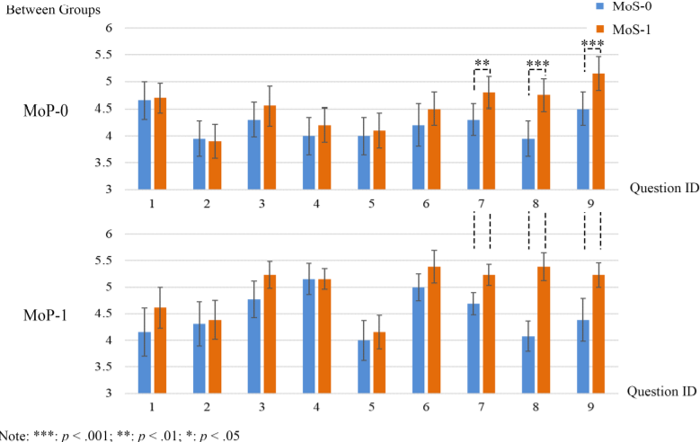
Results and Discussion
Effect of MoS

Slide 18

Results and Discussion
Behavior Data Analysis
5 behavior categories: a-aggressive, b-petting, c-intimacy, d-mimick and e-purposeless
a, b and e are incoherent responses (IR) because it’s human behavior
c and d are coherent responses (CR) because it’s a cat inherent behavior pattern

Slide 19
Results and Discussion
Demographics Analysis
Participants with gaming experience may behave like cats even with lower levels of self-illusion
Stronger desire on the rendering quality of the scenario
39 participants (~51%) are “game experts” while the others are “game amateurs”
On average, “game experts” graded question 4 higher but it didn’t affect the other questions
Females rated questions 5 and 6 higher than males meaning they are more susceptible to Psi

Slide 20
Results and Discussion
Existance and Effect of SI
Participants in MoS-1 reported learning the behavior pattern of the cat better
“Behave like a cat rather than a human” and feel themselves “to be a cat”
Participants with high level SI commit to the role and spontaneously use coherent patterns
Participants in MoS-1 approach the virtual cat as a cat would
Participants in MoS-0 approach the virtual cat as a human would
Long-term role-playing with a high level of SI might make certain attributes became part of a person

Slide 21
Results and Discussion
Factors Affecting SI
Wether or not a personalized avatar and a mirror are provided
Wether or not the mini-games are consistent with the tutorial

Slide 22
Conclusions
The existence of SI was successfully proven
Higher level of SI leads to more commitment to the virtual role and more coherent responses in the VE
The level of SI can be altered by manipulating relevant factors such as giving the participant a set of avatars to choose from or giving them tasks consistent with what is intended for them to do
Psi doesn’t have as much impact as SoE and PI on SI
Further research can be done on the subject, namely with a larger range of manipulations and using an EEG to see the activation states of brain regions related to selfhood
Can have multiple uses, namely in simulation and therapy

Slide 23
Bibliography
Sheng Li; Xiang Gu; Kangrui Yi; Yanlin Yang; Guoping Wang; Dinesh Manocha, “Self-Illusion: A Study on Cognition of Role-Playing in Immersive Virtual Environments from Non-Human Perspective”, in IEEE Transactions on Visualization and Computer Graphics, 14 December 2020, DOI: 10.1109/TVCG.2020.3044563
http://hci.uni-wuerzburg.de/projects/ivbo/
https://gorillaitr.com/2019/09/16/place-plausibility-illusion-ar-consumer-research/

